Slide 1
Digital Portfolio
STUDENT NAME: SUPRIYA V
REGISTER NO AND NMID: 24131190500122041 & BA685A5949AA0FE89BC41204265685D6
DEPARTMENT: BCA II YEAR
COLLEGE: COLLEGE/ UNIVERSITY: GOVERNMENT ARTS &SCIENCE COLLEGE TITTAGUDI/ ANNAMALAI UNIVERSITY

Slide 2
PROJECT TITLE
DIGITED PORTFOLIO

Slide 3


AGENDA
Problem Statement
Project Overview
End Users
Tools and Technologies
Portfolio design and Layout
Features and Functionality
Results and Screenshots
Conclusion
Github Link
3/21/2024 Annual Review

Slide 4

PROBLEM STATEMENT
Identifying the need for a digital portfolio to showcase skills and project's effectively.

Slide 5

PROJECT OVERVIEW
A brief outlines of the digital portfolio project, it's purpose, and scope.

Slide 6

WHO ARE THE END USERS?
Students, professionals, and recruiters who benefit from the portfolio.

Slide 7

TOOLS AND TECHNIQUES
HTML, CSS, JavaScript, and GitHub for development and deployment.

Slide 8
POTFOLIO DESIGN AND LAYOUT
A clean, user-friendly interface with structured sections.
8

Slide 9
FEATURES AND FUNCTIONALITY
Interactive navigation, project display, contact form, and responsive design.

Slide 10

RESULTS AND SCREENSHOTS
Final output showcasing portfolio pages and functionalities.
3/21/2024 Annual Review
10

Slide 11
CONCLUSION
"Thank you for exploring my digital portfolio! I'm excited to collaborate and bring value to innovative projects. Feel free to reach out to me at [Your Contact Information] to discuss potential opportunities. Let's create something amazing together!

Slide 12
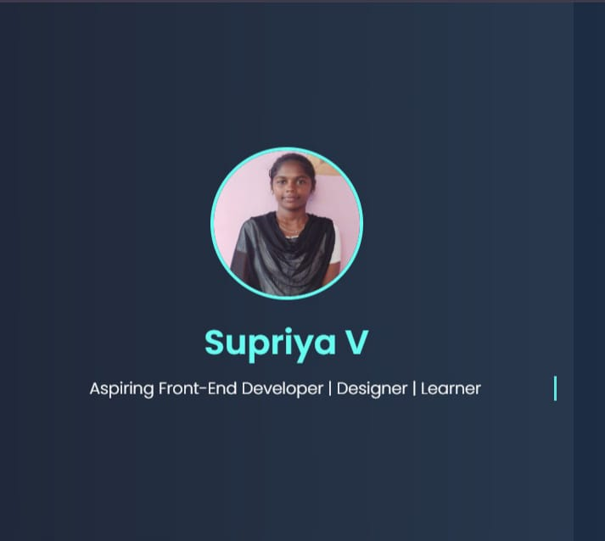
SCREENSHOT AND RESULT

Slide 13
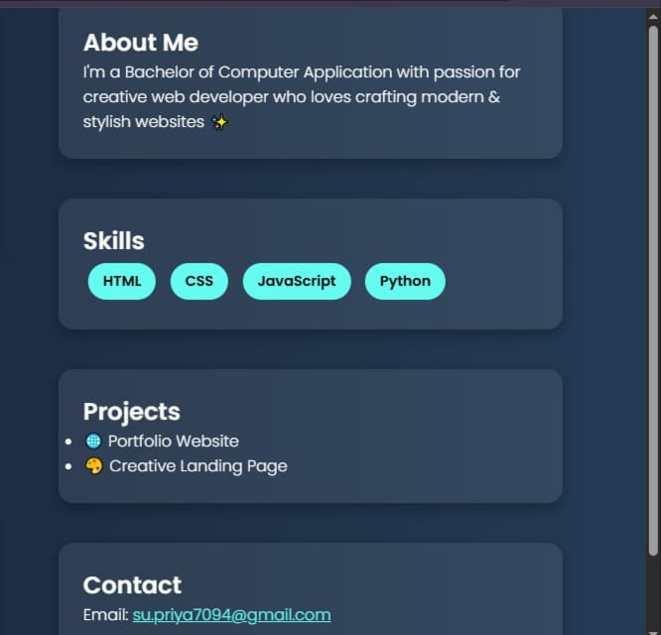
SCREENSHOT AND RESULT

Slide 14
GITHUB LINK
https://github.com/supriya7094-wq/SupriyaV-TNSDC-FWD-DP.git

